Slide 1


TEHRD TRUST’s
KISHKINDA UNIVERSITY
Estd. Under Karnataka Act.no. 20 of 2023
Mount View Campus, Off 28Kms, Ballari – Siruguppa Road,
Near Sindhigeri , GP NO.735 , Hagaluru , Siruguppa Taluk,
Ballari -583120 , Karnataka

Slide 2


Custom Declaration System
Sigma champions
Ashwini R
K M Deepika
Nishath tarannum
Neelavathi
Pratiksha M U

Slide 3
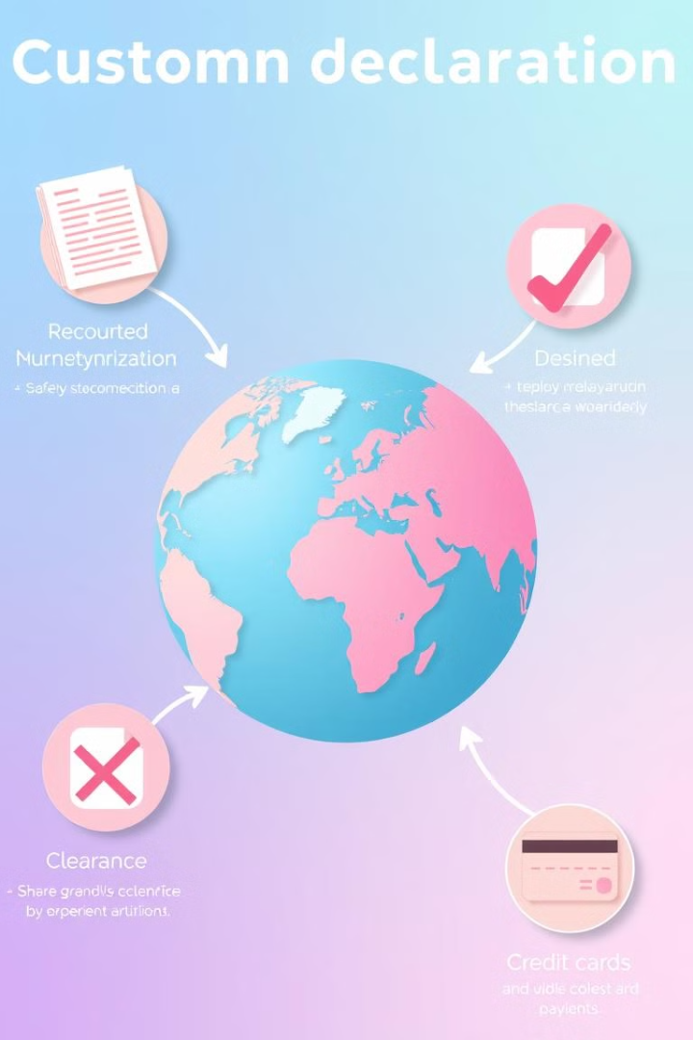
What is a Custom Declaration System?
The Customs Declaration System is a digital management tool designed to streamline the process of handling customs declarations for travelers. It allows users to create, read, update, process, track, and delete customs declarations efficiently. Each declaration contains essential information such as the travelers name, items being declared, and compliance status.

Slide 4

Importance
1
Facilitating Trade:
It helps businesses efficiently navigate customs processes, reducing delays in the import and export of goods.
2
Ensuring Security:
By monitoring what goods enter and leave a country, it helps prevent illegal trade and smuggling.
3
Generating Revenue:
It ensures proper collection of duties and taxes, contributing to national revenues.

Slide 5
Where We Use ?
1.Airports:
2.Land Borders:
3.Customs Authorities:
Used by travelers to declare items when entering or leaving a country, especially for high-value items or restricted goods.
Applied at customs checkpoints for vehicles and individuals crossing borders by road or rail.
Implemented by government agencies responsible for enforcing customs laws and regulations.

Slide 6
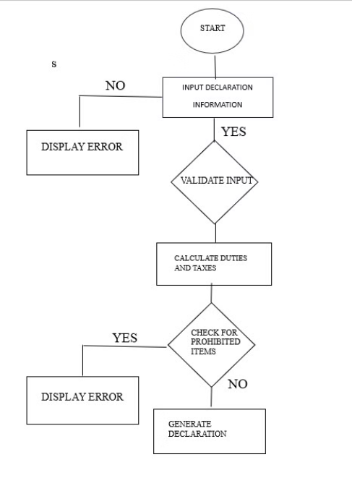
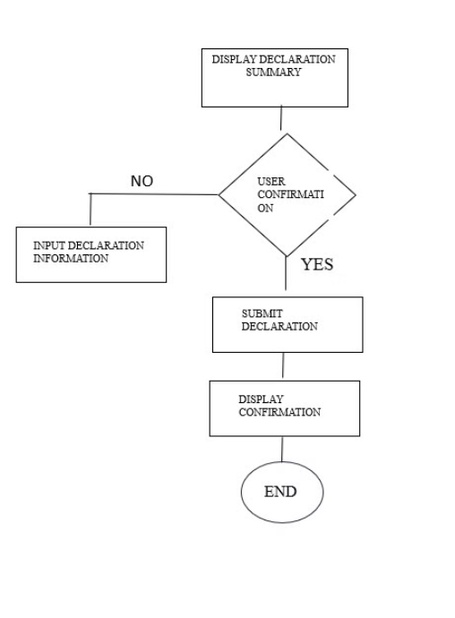
Algorithm

Slide 7
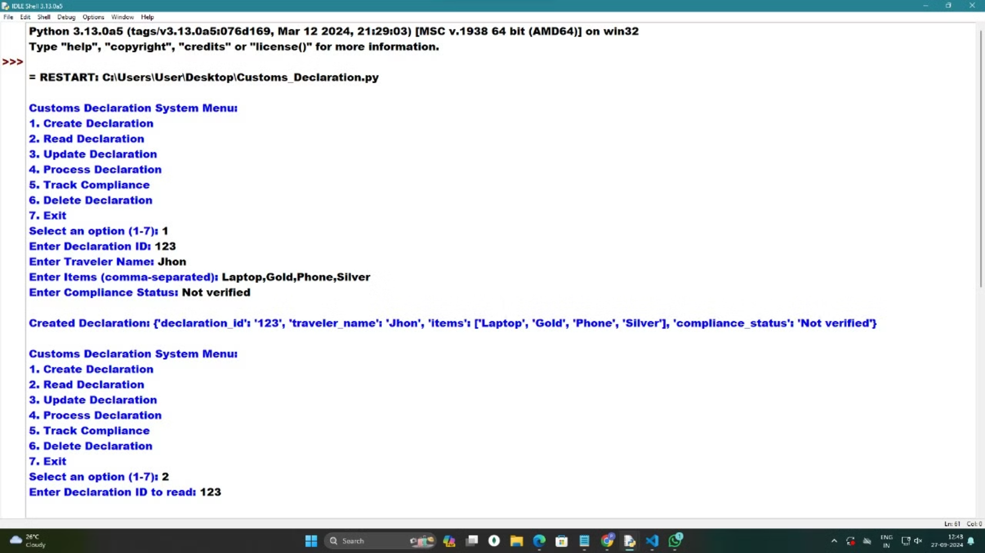
Output

Slide 8
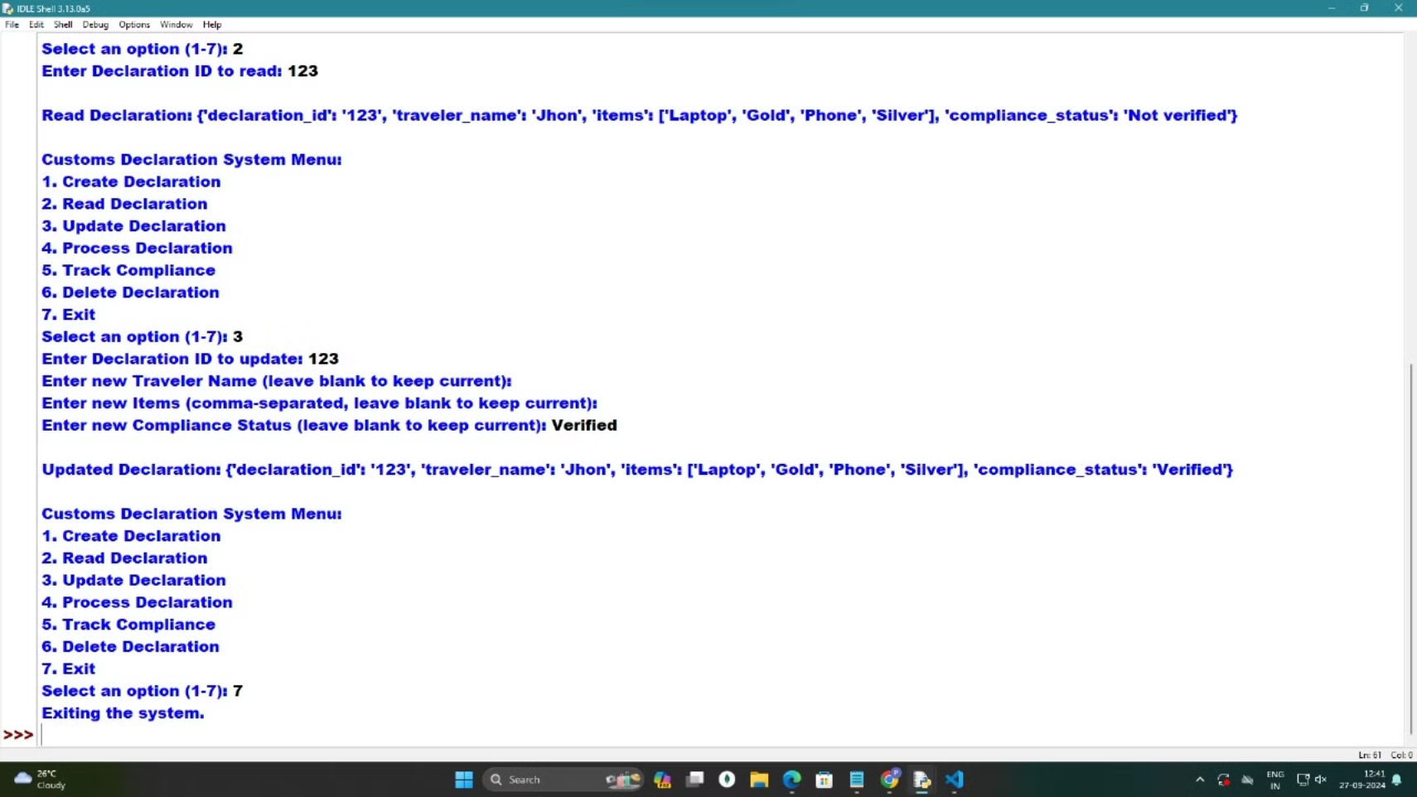

Slide 9

Future Scope
1
Artificial Intelligence Integration
2
Blockchain Technology
Blockchain can enhance security and transparency, ensuring tamper-proof records and streamlined data sharing.
AI-powered systems can automate data analysis, risk assessment, and decision-making, improving efficiency and accuracy.
3
Real-time Data Analytics
4
Training and Support
Real-time data analytics can provide valuable insights into trade patterns, enabling proactive risk management and improved decision-making.
24/7 Support: Establishing robust support systems to assist users with queries and technical issues, ensuring smooth operation

Slide 10

Thank You

